Slide 1
Setup Multi-Node Hadoop Cluster on CentOS and Oracle Virtualbox
Siva Sankar Reddyvari (sxr31390@ucmo.edu)
700693139

Slide 2
Pre-Requisites:
https://www.centos.org/download/, I have installed CentOS7
JDK 1.8
Hadoop 2.9.2
WinSCP – to copy files from local to virtual-machine

Slide 3
About components of Hadoop cluster:
Master Node, keeps the knowledge about the distributed system
Master Node > Name Node: It manages the distributed file system and knows where the store data blocks inside the cluster
Master Node > ResourceManager: which manages the yarn jobs and take care of the scheduling and executing processes on the slave nodes. (job tracker replaced with ResourceManager)
Slave nodes, is actually store the data and provide processing power to run the jobs.
Slave -> NodeManager: which manage the execution and task on the node ( task tracker replaced with NodeManager)
Slave -> Datanode: it manages the actual data physically stored on the node.

Slide 4
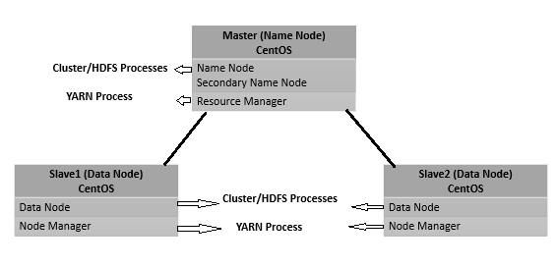
Cluster Topology:

Slide 5
Cluster Setup Information:
Hadoop Name Node: 192.168.56.101 (master)
Hadoop Data Node: 192.168.56.102 (slave1)
Hadoop Data Node: 192.168.56.103 (slave2)

Slide 6
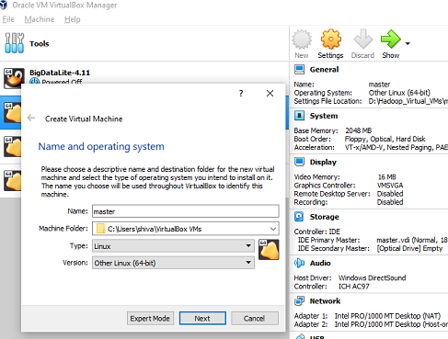
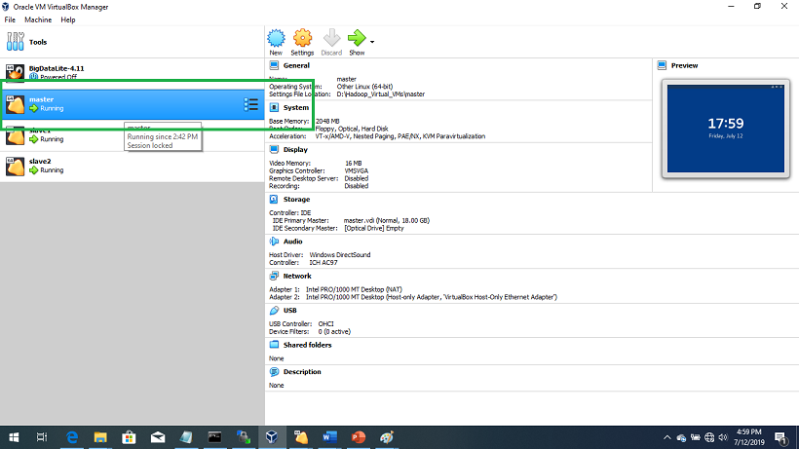
Step1: Create Virtual Machine with name “master” and install CentOS

Slide 7
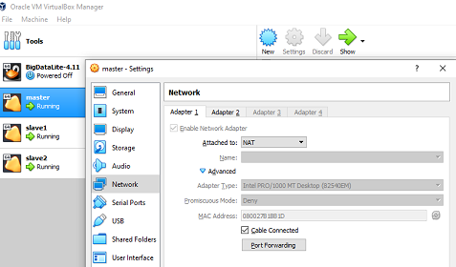
Step2: Name Node basic configurations on Virtualbox settings:
2.1. Make sure adapter 1 is set to NAT. Because user should be able to access the internet to download the required software directly on VM and also should be able to connect talk to a specific node as internal network

Slide 8
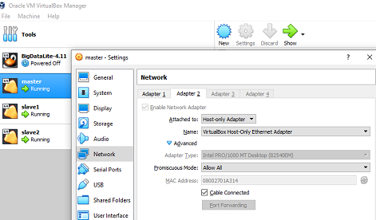
Step2: Name Node basic configurations on Virtualbox settings:
2.2. Adapter2, here we are creating local network of 3 machines(nodes). Select like showing down:

Slide 9
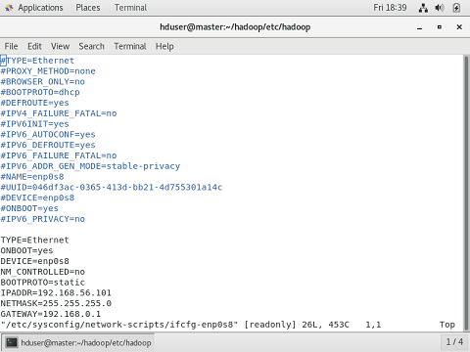
Step3:
Step3: Start master node from virtual box, here the master node up and running and logged in as root to make some configurations. Try ifconfig and check the IP Address is set or not. If not set then follow below steps:
3.1. edit /etc/sysconfig/network-scripts/ifcfg-enp0s8

Slide 10
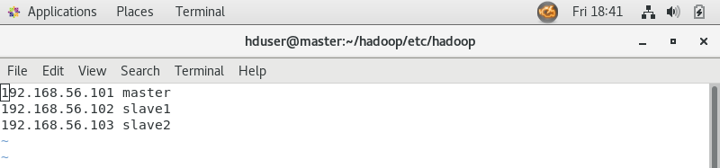
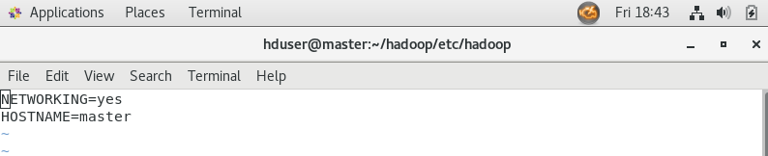
Step3:
3.2. Edit /etc/hosts file like below:
3.3.Edit /etc/sysconfig/network like below:

Slide 11
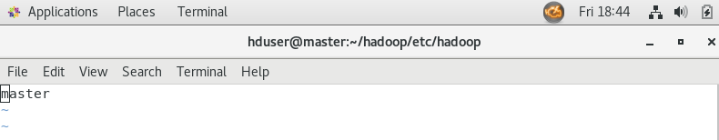
Step3
3.4. Edit /etc/hostname like below:
3.5. Restart network using below command
service network restart

Slide 12
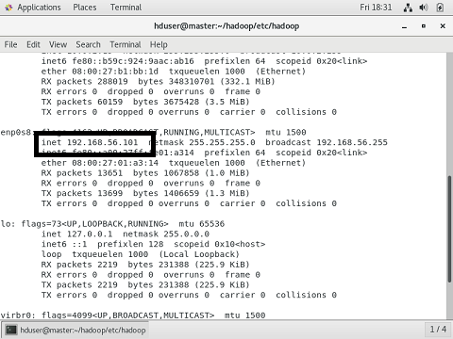
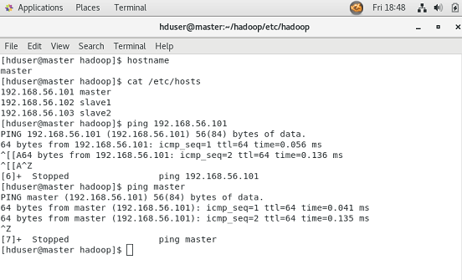
Step3:
3.6. Now cross check all network configurations like shown below:

Slide 13
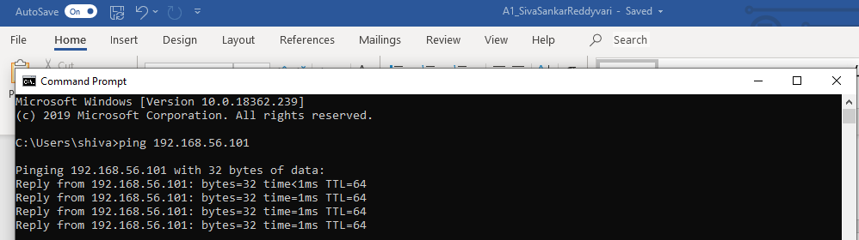
Step3:
No we are able to ping from windows command line as shown below:

Slide 14
Step4:
Step4: Recommended dedicated user for Hadoop to helps to separate Hadoop installation from other software applications and user accounts which are running from the same machine.
# groupadd hadoop
# useradd -G hadoop hduser
# passwd hduser
New password:
Retype new password:

Slide 15
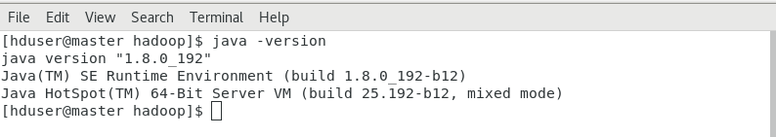
Step5:
Step5: Login as hduser which created above, Install JDK8, download the rpm file and install using below command:
rpm -i <jdk filename>
After installation check version,

Slide 16
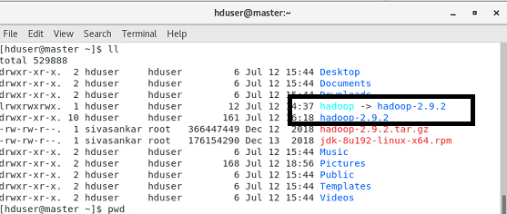
Step6
Step6: Install Hadoop2.9.2, download hadoop2.9.2 and extract and also create symlink for Hadoop (benefits: don’t have to type the longer folder name along with version and also in future will be able to replace the folder with an version without change the folder name in many places).
symlink example: # ln -s hadoop2.9.2 Hadoop

Slide 17
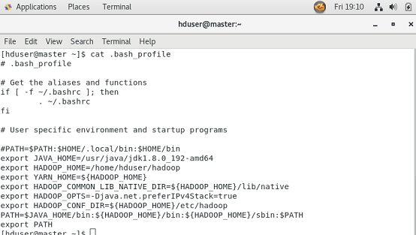
Step7: Edit .bash_profile file, setup paths
After changes done, run to apply changes
# source .bash_profile

Slide 18
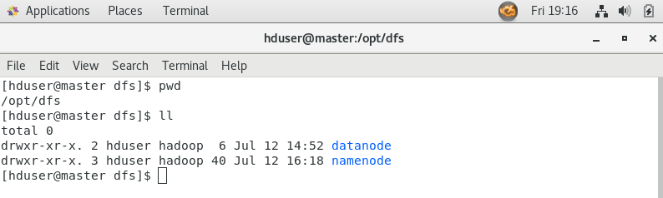
Step8:
Step8: Login as root, create namenode and datanode folders to store various blocks information store. I have created these folders under /opt/dfs/:
root$master # cd /opt/
root$master # mkdir -p dfs/namenode
root$master # mkdir -p dfs/datanode
root$master # chown -R hduser:Hadoop dfs

Slide 19
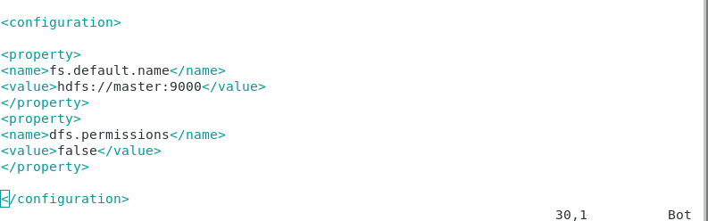
Step9: Configure Hadoop, login as hduser
$ cd $HADOOP_CONF_DIR
Edit Hadoop-env.sh
Set JAVA_HOME=/usr/java/jdk…. <java path>
Set HADOOP_LOG_DIR=home/hduser/hadoop/logs
Edit core-site.xml

Slide 20
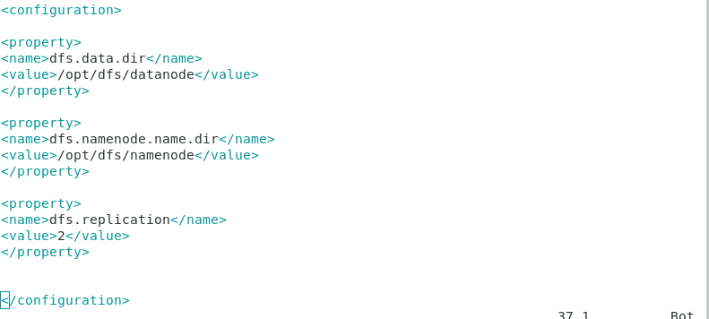
Step9: Configure Hadoop, login as hduser
Edit hdfs-site.xml

Slide 21
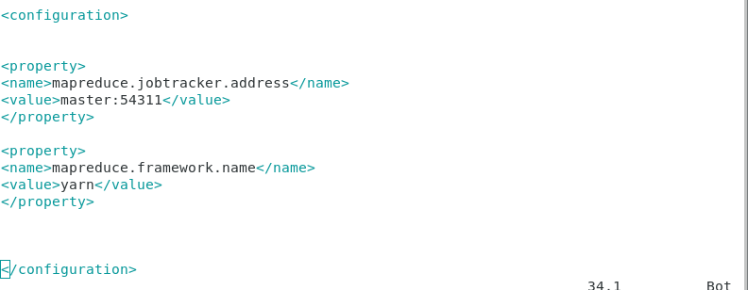
Step9: Configure Hadoop, login as hduser
Edit mapred-site.xml

Slide 22
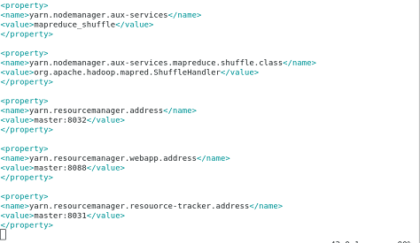
Step9: Configure Hadoop, login as hduser
Edit yarn-site.xml

Slide 23
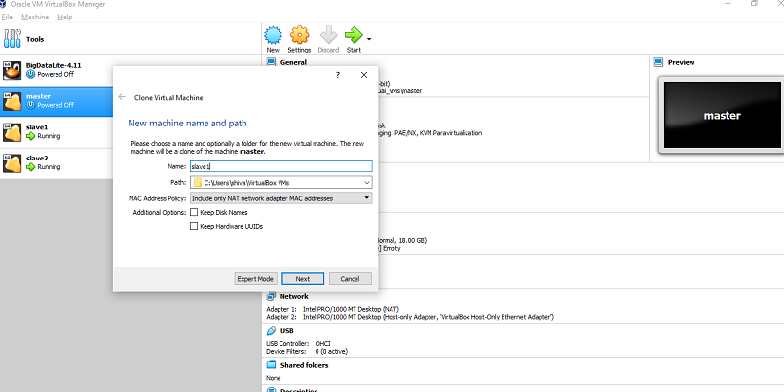
Step10: clone slave1 and slave2 from master node as shown below:
After clone both slave1 and slave2, start all master and slave1 and slave2 nodes.

Slide 24
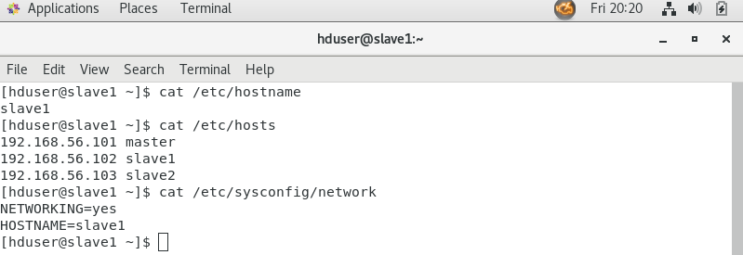
Step10: clone slave1 and slave2 from master node as shown below:
10.1. Login as root and do the changes for both slave nodes.
Edit /etc/hostname , /etc/sysconfig/network as shown below:
After clone both slave1 and slave2, start all master and slave1 and slave2 nodes.

Slide 25
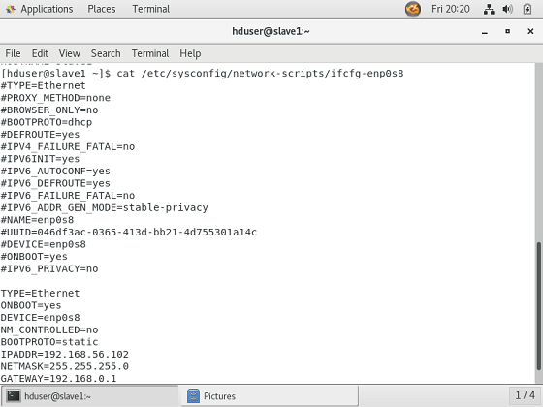
Step10: clone slave1 and slave2 from master node as shown below:
10.1. Login as root and do the changes for both slave nodes.
edit /etc/sysconfig/network-scripts/ifcfg-enp0s8
After clone both slave1 and slave2, start all master and slave1 and slave2 nodes.

Slide 26
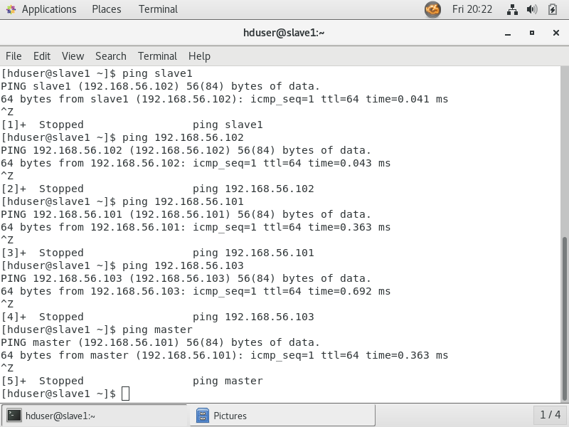
Step10: clone slave1 and slave2 from master node as shown below:
Restart network:
service network restart
Now cross check all network configurations like shown below:

Slide 27
Step11: Configuring SSH key pair login
[hduser@master]$ ssh-keygen -t rsa
[hduser@master]$ ssh-copy-id -i ~/.ssh/id_rsa.pub hduser@master
[hduser@master]$ ssh-copy-id -i ~/.ssh/id_rsa.pub hduser@slave1
[hduser@master]$ ssh-copy-id -i ~/.ssh/id_rsa.pub hduser@slave2
[hduser@master]$ chmod 0600 ~/.ssh/authorized_keys
Now, can login from one node to another node using ssh

Slide 28
Step12: Format Name Node on Hadoop Master only
[hduser@master]$ hadoop namenode -format
If you miss the logs folder creation, create under etc/hadoop folder
[hduser@master]$ mkdir logs

Slide 29
Step13: Start Hadoop Services
[hduser@master]$ start-dfs.sh
(Starts the Hadoop DFS daemons, the namenode and datanodes)
[hduser@master]$ start-yarn.sh
(starts ResourceManager and NodeManager)

Slide 30
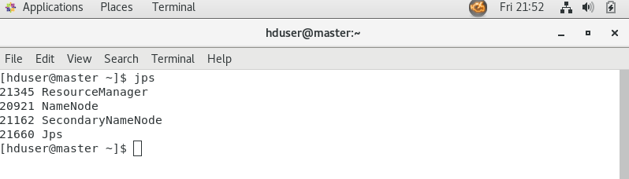
Step13: Start Hadoop Services
Jobs running from master node:

Slide 31
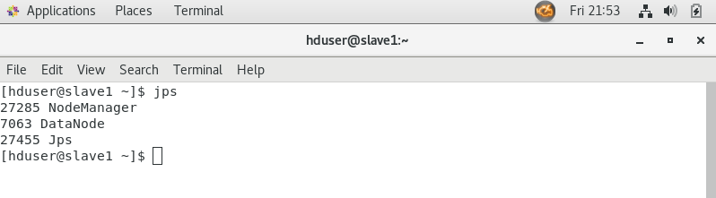
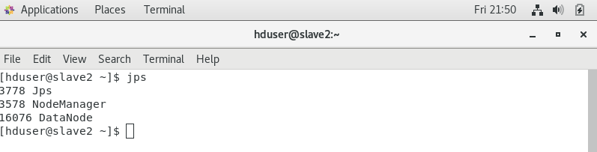
Step13: Start Hadoop Services
Jobs running from slave1 node:
Jobs running from slave2 node:

Slide 32
THANK YOU
Siva Sankar Reddyvari (sxr31390@ucmo.edu)
700693139

